Slide 1
Yannick Moy
Current Research Projects
SPARK Product Manager - RD Lead

Slide 2
Why Research Projects?
To do something fun.

Slide 3
Why Research Projects?
To do something fun.
To get public money.

Slide 4
Why Research Projects?
To do something fun.
To get public money.
To investigate with others solutions to difficult challenges.
To try out state-of-the-art techniques from academia.
To better understand the current needs of our customers.
To anticipate together future needs.
To develop the technology that will become new tools.

Slide 5

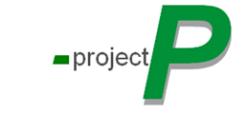
Past Research Projects
Non instrumented coverage analysis for DO-178
Simplifying the use of formal methods
MDE with qualifiable, tunable and open-source code generators
COUVERTURE

Slide 6
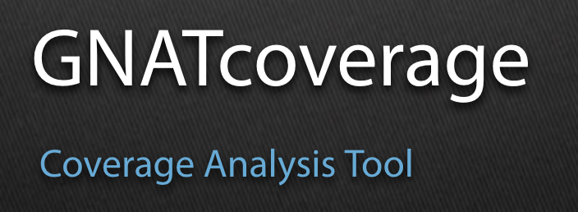


Results of Past Research Projects
Qualified non instrumented coverage analysis for many domains
Combined verification by testing and formal methods
Qualifiable, customizable code generator from Simulink / Stateflow to MISRA C and SPARK

Slide 7
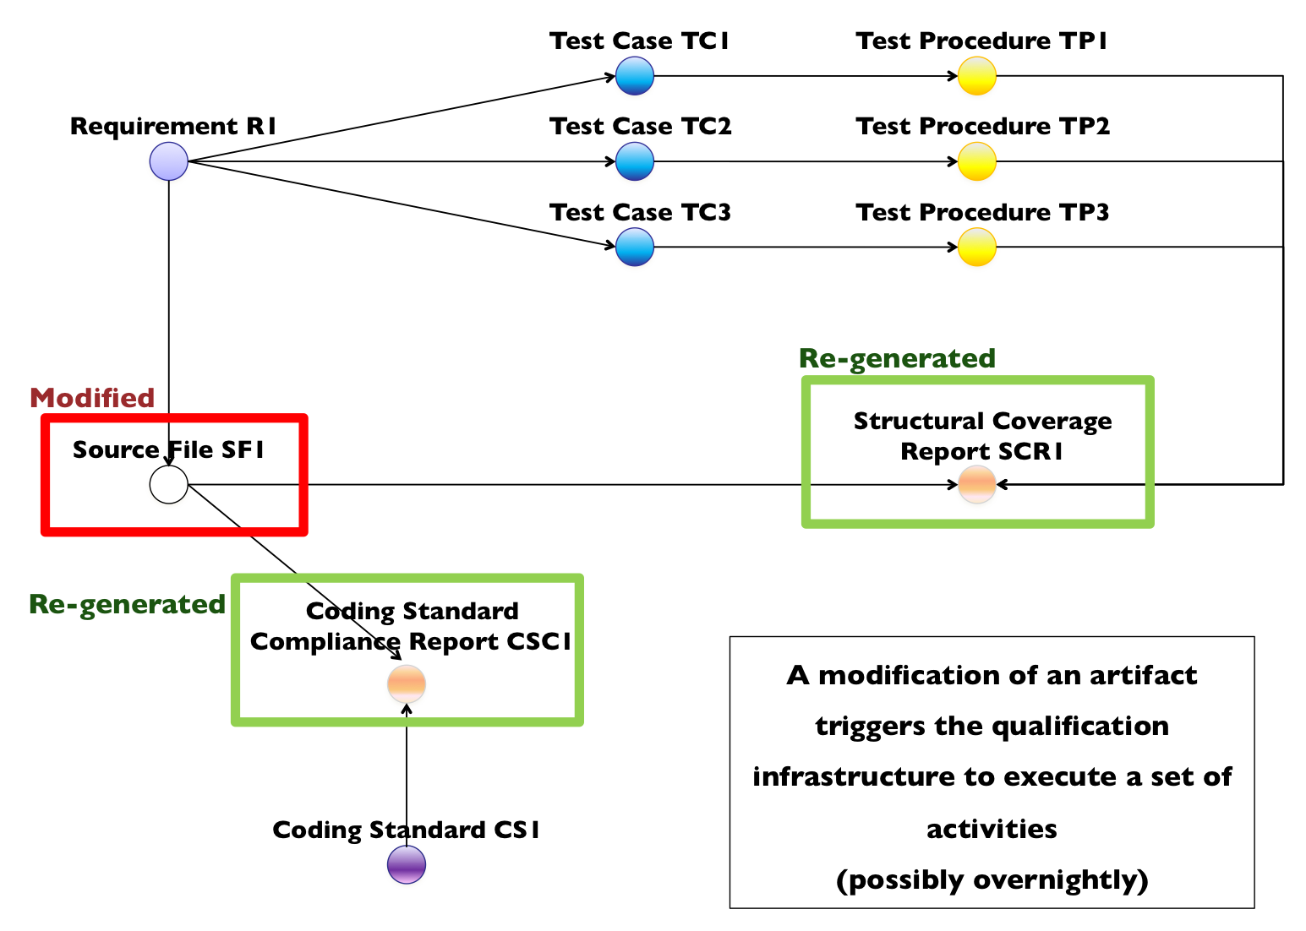
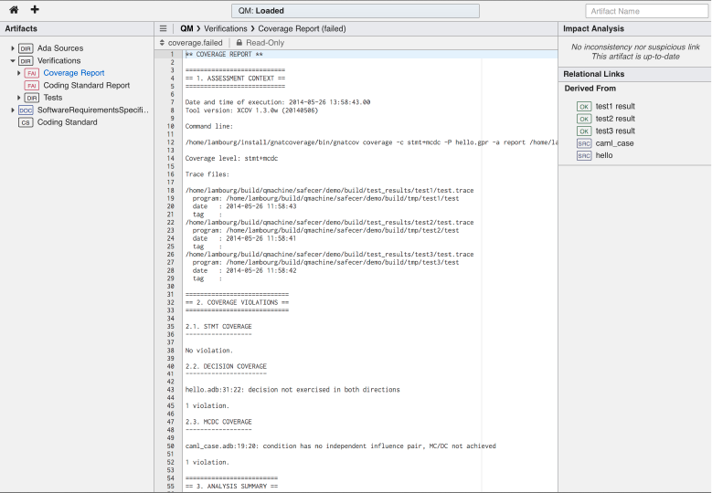
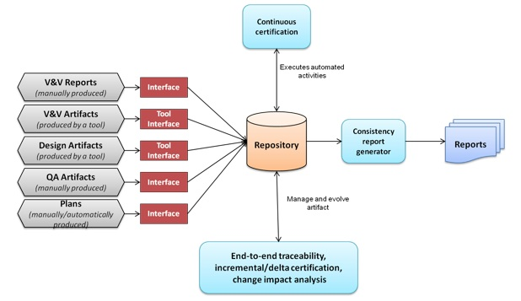
Research Might Not Turn Into Tools
Qualifying Machine (5 R&D projets) – agile qualification of tools for DO-178, that avoids the “big freeze” problem

Slide 8
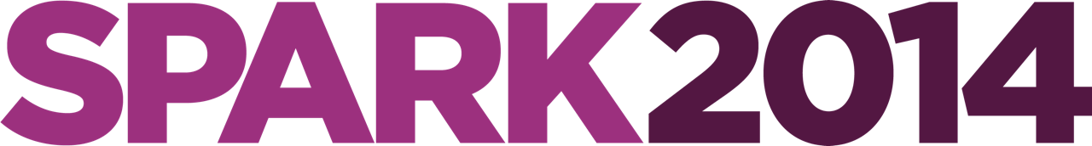
Current Research Projects
O’PAVES
SOPRANO
ADASQUORE
VECOLIB
PROOFINUSE
DENSO
HONDA
CAP 2018

Slide 9
SOPRANO – core proof technology
3 years – in the middle
Goal: combine SMT and CP in a new prover
Achievements:
New prover “Popop” being created at CEA
Interest of CP validated on AdaCore benchmark
Better floating point support in prover Alt-Ergo

Slide 10
VECOLIB – proof on containers
3 years – in the middle
Goal: prove implementation and use of container library
Achievements:
New container library for 2017 (dev on GitHub)
Proof of container clients much easier
Generation of limited forms of loop invariants

Slide 11
ADASQUORE – metrics on proof
2 years – in the last year
Goal:
generate metrics on formal development & verification
include metrics in indicators in project dashboard
Achievements:
New techno Libadalang for 2017 (dev on GitHub)
New metrics for SPARK developments (SPARK lines count, contracts count + completeness + complexity)

Slide 12
O’PAVES – autonomous car platform
1 year
Goals:
provide FLOSS platform (hard+soft) for autonomous driving
use SPARK and the Ada Driver Library
Achievements:
PCB designed and printed
General architecture designed

Slide 13
DENSO – fault model & FFI
2nd year
Goals:
ensure correctness of fault model
use SPARK in C context for proving Freedom From Interference
Achievements:
Fault model in Why3, proved correct
SPARK-to-C code generator from SPARK + access types to C

Slide 14
HONDA – formal and modeling
1st stage – 3 stages total
Goals:
write specifications in a formal notation
verify specifications at code level (mix of C and Simulink)
Achievements:
Contracts written in SPARK from 4 requirements
Contracts checked formally (SPARK) or dynamically (C)

Slide 15
CAP 2018 – certified drone autopilot
3 years – two years to go
Goal: produce a drone autopilot certifiable to DO-178C
Achievements:
Plans according to DO-178C are finished
First application of SPARK to the new DO-178C
Port of GNAT / GNATcoverage to ARM Cortex M7
Use of hardware probes in GNATcoverage for ARM Cortex M7

Slide 16
PROOFINUSE – next gen for SPARK
3 years – in the end
Goals: Solve four difficult problems in proof technology
Achievements:
Support of bitwise and modular arithmetic (in SPARK Pro 16)
Support of counterexamples (in SPARK Pro 16)
Native prover support of floats (in SPARK Pro 17 or 18)
Interactive proof at source code level (in SPARK Pro 18)

Slide 17
Next Research Projects
SYSTEM TO SOFTWARE INTEGRITY PRESERVATION
Ada
SPARK
MISRA C
SysML
AADL
Simulink
Stateflow
Structured NL
AGREE OCRA OCL
Assertion
blocks
Contracts

